Slide 1
רשתות תקשורת
1
מבוא
הקורס מבוסס על הספר:
Computer Networking: A Top-Down Approach
9th edition
Jim Kurose, Keith Ross

Slide 2
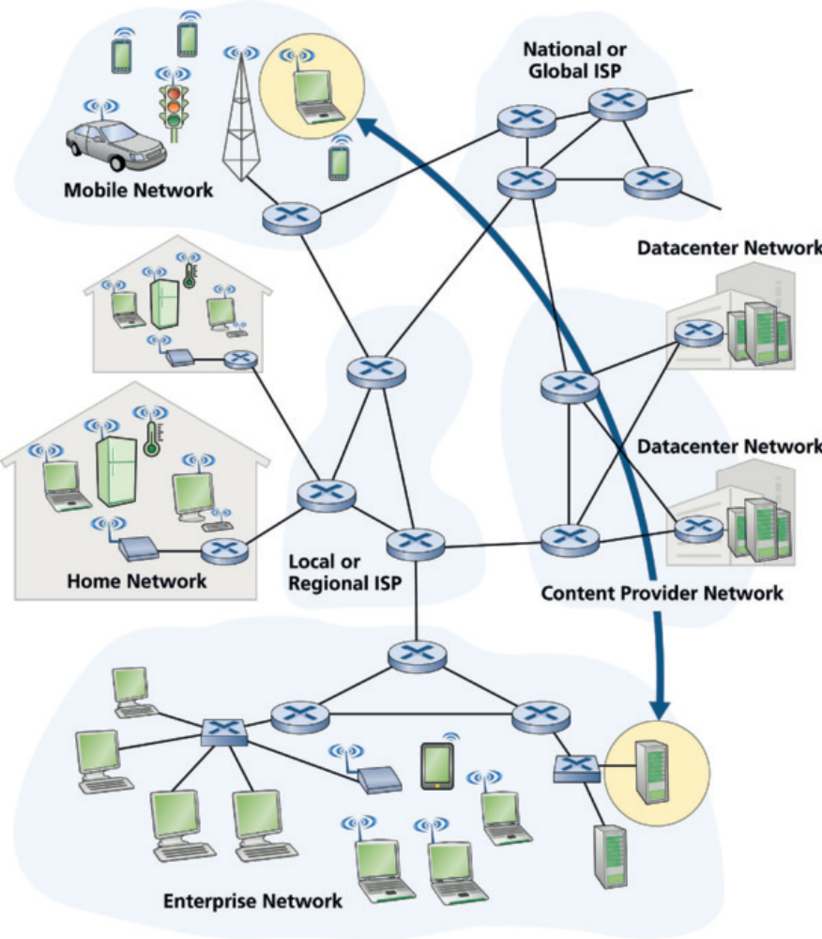
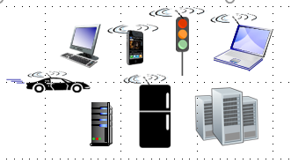

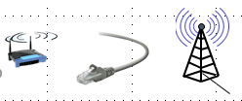
רשת האינטרנט
הרשת מכילה:
התקני חישוב
תחנות קצה
שרת לקוח, P2P
IoT
מתגים switches
נתבים routers
קווי תקשורת
fiber, copper
radio, satellite
רשת (ענן) אוסף של התקנים, נתבים, וקווי תקשורת.

Slide 3
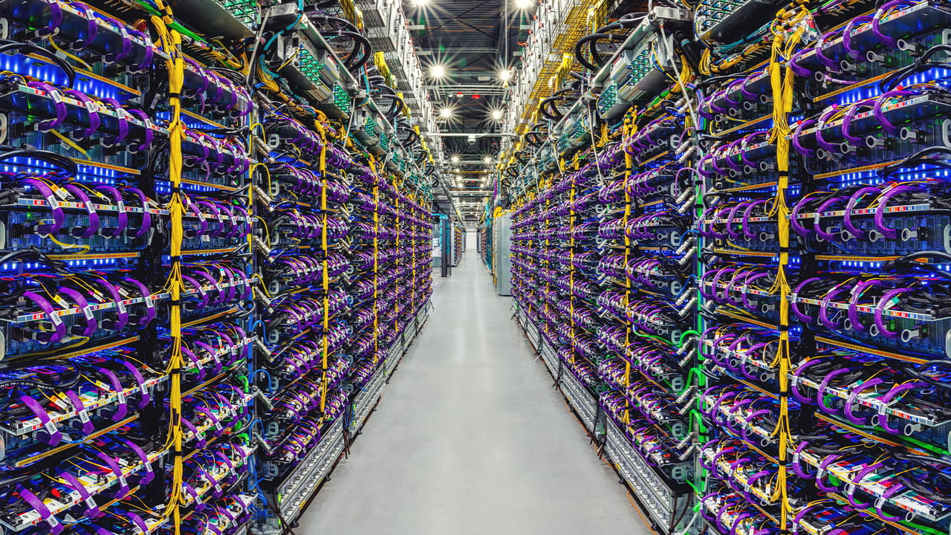
מרכז נתונים (חוות שרתים) - Data Center
רוב הגלישה באינטרנט היא לשרתים של ספקי תוכן Content Providers – Google, Facebook, Netflix
השרתים ממוקמים במרכזי נתונים שמכילים אלפי שרתים.
Google הקימה מעל 30 מרכזי נתונים ברחבי העולם.
מרכזי הנתונים מחוברים ביניהם, התוכן נשמר בכמה מרכזים ומסופק מהקרוב.
מרכזי הנתונים משמשים גם לאחסון שרתים בענן.

Slide 4
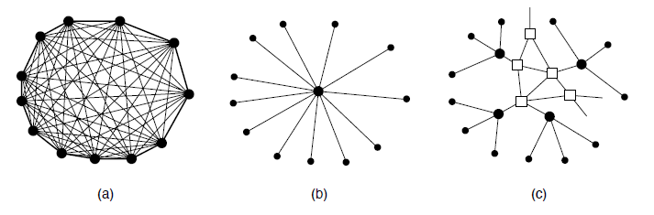
איך לחבר את ספקי שרות האינטרנט - ISP
משתמשי הקצה מחוברים לאינטרנט באמצעות ספקי שרות אינטרנט - ISP
גם מרכזי הנתונים מחוברים ל- ISP
בעיה: כדי שכל מחשב באינטרנט יוכל לגשת לכל מחשב, יש צורך לחבר את כל מיליוני ה- ISP ביניהם
זה דורש N² חיבורים!
(a) Fully interconnected network. (b) Centralized switch. (c) Two-level hierarchy

Slide 5

מבנה האינטרנט הוא רשת של רשתות
פתרון: מבנה האינטרנט הוא היררכי
ספק האינטרנט מחובר לספק אזורי
הספקים האזוריים מחוברים למספר מצומצם של ספקים עולמיים
תקשורת בין משתמשי קצה שמחוברים לאותו ISP, תעשה באמצעות אותו ISP
לספקי תוכן יש רשת משלהם
…
…
access
net
access
net
access
net
access
net
access
net
IXP
access
net
access
net
ISP A
…
…
Content provider network
access
net
IXP
ISP B
access
net
ISP C
access
net
access
net
access
net
regional ISP
access
net
…
access
net
access
net
…
access
net

Slide 6
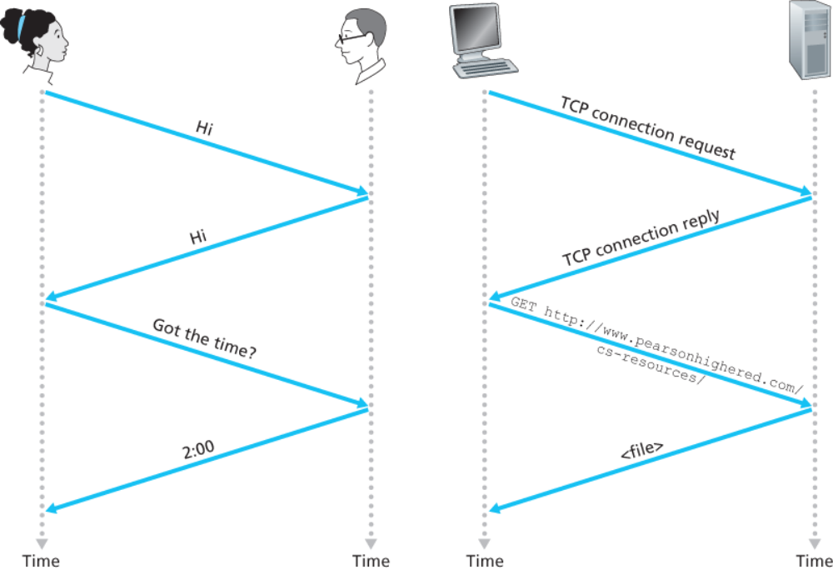
פרוטוקול
פרוטוקול מגדיר את הפורמט והסדר של ההודעות המועברות בתקשורת, וכן את הפעולה המתבצעת מהעברת ההודעה.
לדוגמה, אם ההודעה מכילה בנוסף לתוכן, את כתובת השולח וכתובת המקבל, כל חלק חייב להיות במקום מסוים ובפורמט מסוים.

Slide 7

מודל השכבות
כדי לפשט את המבנה של רשת תקשורת מחלקים אותה לחלקים הנקראים שכבות.
כל שכבה מממשת שרות, ומספקת את השרות באמצעות ממשק מוגדר לשכבה שמעליה (ולכן החלקים נקראים שכבות).
בדומה למחלקה בתכנות מונחה עצמים, אפשר להחליף מימוש של שכבה בלי לשנות את יתר השכבות.
ישנו מודל המחלק את מבנה הרשת לשבע שכבות אך את רשת האינטרנט מקובל לחלק לחמש שכבות
application
socket
application
controlled by
app developer
process
process
transport
transport
network
network
controlled
by OS
link
Internet
link
physical
physical

Slide 8
מודל חמש השכבות של רשת האיטרנט
application: supporting network applications
  HTTP, IMAP, SMTP, DNS
transport: process-process data transfer
  TCP, UDP
network: routing of packets from source to destination
  IP, routing protocols
link: data transfer between neighboring network elements
  Ethernet, 802.11 (WiFi)
physical: bits on the wire
application
application
transport
transport
network
network
link
link
physical
physical

Slide 9
Encapsulation
- כימוס, עיטוףEncapsulation
application
transport
network
link
physical
application
transport
network
link
physical
message
M
M
segment
H_{t}
M
H_{t}
M
packet
H_{n}
H_{t}
M
H_{n}
H_{t}
M
frame
H_{l}
H_{n}
H_{t}
M
H_{l}
H_{n}
H_{t}
M
source
destination

Slide 10
Transport layer Encapsulation
application
transport
network
link
physical
application
transport
network
link
physical
M
Application exchanges messages to implement some application using services of transport layer
H_{t}
M
Transport layer protocol encapsulates application-layer message, M, with transport-layer header H_{t} to create a transport-layer segment
H_{t} used by transport layer protocol to implement its service
Transport-layer protocol transfers M (e.g., reliably) from one process to another, using services of network layer
source
destination

Slide 11
Network layer Encapsulation
application
transport
network
link
physical
application
transport
network
link
physical
M
H_{t}
M
H_{n}
H_{t}
M
Network layer protocol encapsulates transport-layer segment [H_{t} | M] with network layer-layer header H_{n} to create a network-layer packet
H_{n} used by network layer protocol to implement its service
Network-layer protocol transfers network -layer packet [H_{n} |H_{t} | M] from one host to another, using link layer services
source
destination

Slide 12
Link layer Encapsulation
H_{n}
H_{t}
M
application
transport
network
link
physical
M
application
transport
network
link
physical
H_{t}
M
H_{n}
H_{t}
M
H_{l}
H_{n}
H_{t}
M
link-layer protocol encapsulates network datagram [H_{n}| [H_{t} |M], with link-layer header H_{l} to create a link-layer frame
Link layer protocol transfers frame
[H_{l} |H_{n}| [H_{t} |M] from host to neighboring
host, using physical-layer
source
destination

Slide 13
Encapsulation: an end-end view
source
message
M
application
transport
network
link
physical
segment
H_{t}
M
H_{t}
packet
H_{n}
H_{t}
H_{n}
M
frame
H_{l}
H_{n}
H_{t}
M
link
physical
switch
destination
H_{n}
H_{t}
M
network
link
physical
H_{n}
H_{t}
M
M
application
transport
network
link
physical
H_{l}
H_{n}
H_{t}
M
H_{t}
M
H_{n}
H_{t}
M
router
H_{l}
H_{n}
H_{t}
M

Slide 14


הנתונים הנשלחים ברשת מחולקים למנות - packets
עִקוב במשלוח המנה -packet transmission delay
host sending function:
takes application message
breaks into smaller chunks, known as packets, of length L bits
transmits packet into access network at transmission rate R
two packets,
L bits each
2
1
host
R: link transmission rate
packet
transmission
delay
time needed to
transmit L-bit
packet into link
L (bits)
R (bits/sec)
=
=

Slide 15
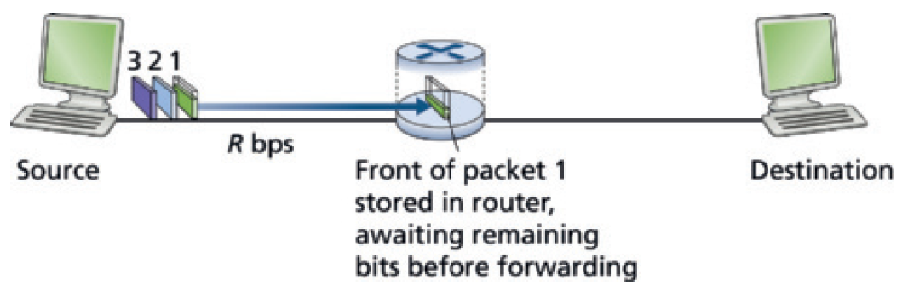
עִקוב במשלוח המנה -packet transmission delay
דוגמאות
The amount of time, until the destination has received the first packet:
At time L/R seconds, the source has transmitted the entire packet.
The router can begin to transmit the packet onto the outbound link.
At time 2L/R, the router has transmitted the entire packet.
Thus, the total delay is 2L/R.

Slide 16
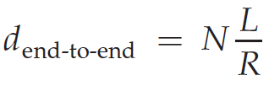
עִקוב במשלוח המנה -packet transmission delay
דוגמאות
The amount of time, until the destination has received all three packets:
At time L/R, the router begins to forward the first packet.
But also at time L/R the source will begin to send the second packet.
At time 2L/R, the destination has received the first packet
and the router has received the second packet.
Thus, at time 4L/R the destination has received all three packets.
In general, sending a packet over N links each of rate R
(thus, there are N-1 routers between source and destination).
the end-to-end delay is:

Slide 17
המנות עוברות באמצעות נתבים מהשולח למקבל
הנתב מבצע מיתוג מנות – packet switching
1. Routing:
determine source-destination paths taken by packets
routing algorithms
different packet may take different routes
routing algorithm
routing algorithm
local forwarding table
local forwarding table
header value
output link
0100
0101
0111
1001
3
2
2
1
2. Forwarding:
move (switch) arriving packets from router’s input link to appropriate router output link
destination address in arriving
packet’s header
1
3
2
0111

Slide 18



Packet-switching: store-and-forward
L bits
per packet
source
3
2
1
destination
R bps
R bps
store and forward: entire packet must arrive at router before it can be transmitted on next link
packet transmission delay: takes L/R seconds to transmit (push out) L-bit packet into link at R bps
One-hop numerical example:
L = 10 Kbits
R = 100 Mbps
one-hop transmission delay = 0.1 msec

Slide 19
Alternative to packet switching: circuit switching
end-end resources allocated to, reserved for “call” between source and destination
in diagram, each link has four circuits.
  call gets 2nd circuit in top link and 1st circuit in right link.
dedicated resources: no sharing
  circuit-like (guaranteed) performance
circuit segment idle if not used by call (no sharing)
commonly used in traditional telephone networks

Slide 20
Packet switching versus circuit switching
circuit-switching: Path of Data - Sequential along one fixed path
Bandwidth Use – Fixed guaranteed bandwidth
Latency - Low and predictable
packet-switching: Path of Data - Independent paths; may arrive out of order
Bandwidth Use - Dynamic and shared
Latency - Variable ,depends on network congestion
example:
1 Gb/s link
each user:
  100 Mb/s when “active”
  active 10% of time
…..
N
users
1 Gbps link
Q: how many users can use this network under circuit-switching and packet switching?
circuit-switching: 10 users
packet switching: with 35 users, probability > 10 active at same time is very small

Slide 21
queueing delay עִקוב במשלוח המנה -
Queueing occurs when work arrives faster than it can be serviced:
Packet queuing and loss: if arrival rate (in bps) to link exceeds transmission rate (bps) of link for some period of time:
packets will queue in output buffer, waiting to be transmitted on output link
packets can be dropped (lost) if memory (buffer) in router fills up
R = 100 Mb/s
C
A
R = 1.5 Mb/s
D
B
E
queue of packets
waiting for transmission over output link

Slide 22
packet delay may cause packet loss
packets queue in router buffers, waiting for turn for transmission
  queue length grows when arrival rate to link (temporarily) exceeds output link capacity
packet loss occurs when memory to hold queued packets fills up
packet being transmitted (transmission delay)
A
B
packets in buffers (queueing delay)
free (available) buffers: arriving packets
dropped (loss) if no free buffers

Slide 23


Packet queueing delay (revisited)
a: average packet arrival rate
L: packet length (bits)
R: link bandwidth (bit transmission rate)
average queueing delay
L
a
.
:
arrival rate of bits
“traffic
intensity”
R
service rate of bits
traffic intensity = La/R
1
La/R ~ 0: avg. queueing delay small
La/R <= 1: avg. queueing delay large
La/R > 1: more “work” arriving is more than can be serviced - average delay infinite!
La/R ~ 0
La/R -> 1

Slide 24
Packet delay: four sources
transmission
A
propagation
B
processing
queueing
d = d_{proc} + d_{queue} + d_{trans} + d_{prop}
d_{queue}: queueing delay
time waiting at output link for transmission
depends on congestion level of router
d_{trans}: transmission delay:
L: packet length (bits)
R: link transmission rate (bps)
d_{trans} = L/R

Slide 25
Packet delay: four sources
transmission
A
propagation
B
processing
queueing
d = d_{proc} + d_{queue} + d_{trans} + d_{prop}
d_{proc}: processing
check bit errors
determine output link
typically < microsecs
d_{prop}: propagation delay:
d: length of physical link
s: propagation speed (~2x10⁸ m/sec)
d_{prop} = d/s

Slide 26
Throughput
throughput: rate (bits/time unit) at which bits are being sent from sender to receiver
  instantaneous: rate at given point in time
  average: rate over longer period of time
link capacity
R_{s} bits/sec
link capacity
R_{c} bits/sec
pipe that can carry
fluid at rate
(R_{s} bits/sec)
pipe that can carry
fluid at rate
(R_{c} bits/sec)
server sends bits
(fluid) into pipe
server, with
file of F bits
to send to client

Slide 27
Throughput
R_{s} < R_{c} What is average end-end throughput?
R_{s} bits/sec
R_{c} bits/sec
R_{s} > R_{c} What is average end-end throughput?
R_{s} bits/sec
R_{c} bits/sec
bottleneck link
link on end-end path that constrains end-end throughput

Slide 28
Throughput: network scenario
per-connection end-end throughput: min(R_{c},R_{s},R/10)
in practice: R_{c} or R_{s} is often bottleneck
R_{s}
R_{s}
R_{s}
R
R_{c}
R_{c}
R_{c}
10 connections (fairly) share backbone bottleneck link R bits/sec

Slide 29
“Real” Internet delays and routes
what do “real” Internet delay & loss look like?
traceroute program: provides delay measurement from source to router along end-end Internet path towards destination. For all i:
  sends three packets that will reach router i on path towards destination (with time-to-live field value of i)
  router i will return packets to sender
  sender measures time interval between transmission and reply
3 probes
3 probes
3 probes

Slide 30
Real Internet delays and routes
traceroute: gaia.cs.umass.edu to www.eurecom.fr
3 delay measurements from
gaia.cs.umass.edu to cs-gw.cs.umass.edu
1 cs-gw (128.119.240.254) 1 ms 1 ms 2 ms
2 border1-rt-fa5-1-0.gw.umass.edu (128.119.3.145) 1 ms 1 ms 2 ms
3 cht-vbns.gw.umass.edu (128.119.3.130) 6 ms 5 ms 5 ms
4 jn1-at1-0-0-19.wor.vbns.net (204.147.132.129) 16 ms 11 ms 13 ms
5 jn1-so7-0-0-0.wae.vbns.net (204.147.136.136) 21 ms 18 ms 18 ms
6 abilene-vbns.abilene.ucaid.edu (198.32.11.9) 22 ms 18 ms 22 ms
7 nycm-wash.abilene.ucaid.edu (198.32.8.46) 22 ms 22 ms 22 ms
8 62.40.103.253 (62.40.103.253) 104 ms 109 ms 106 ms
9 de2-1.de1.de.geant.net (62.40.96.129) 109 ms 102 ms 104 ms
10 de.fr1.fr.geant.net (62.40.96.50) 113 ms 121 ms 114 ms
11 renater-gw.fr1.fr.geant.net (62.40.103.54) 112 ms 114 ms 112 ms
12 nio-n2.cssi.renater.fr (193.51.206.13) 111 ms 114 ms 116 ms
13 nice.cssi.renater.fr (195.220.98.102) 123 ms 125 ms 124 ms
14 r3t2-nice.cssi.renater.fr (195.220.98.110) 126 ms 126 ms 124 ms
15 eurecom-valbonne.r3t2.ft.net (193.48.50.54) 135 ms 128 ms 133 ms
16 194.214.211.25 (194.214.211.25) 126 ms 128 ms 126 ms
17 * * *
18 * * *
19 fantasia.eurecom.fr (193.55.113.142) 132 ms 128 ms 136 ms
3 delay measurements
to border1-rt-fa5-1-0.gw.umass.edu
trans-oceanic link
looks like delays decrease! Why?
* means no response (probe lost, router not replying)
* Do some traceroutes from exotic countries at www.traceroute.org

